Slide 1
CSCI3420 Tutorial 3
Basic ISA
Address Computation
Project Phase 1
Donald Cheung

Slide 2
Outline
Basic ISA
Address Computation
Project Phase 1
Problems
QtSpim

Slide 3
Basic isa

Slide 4
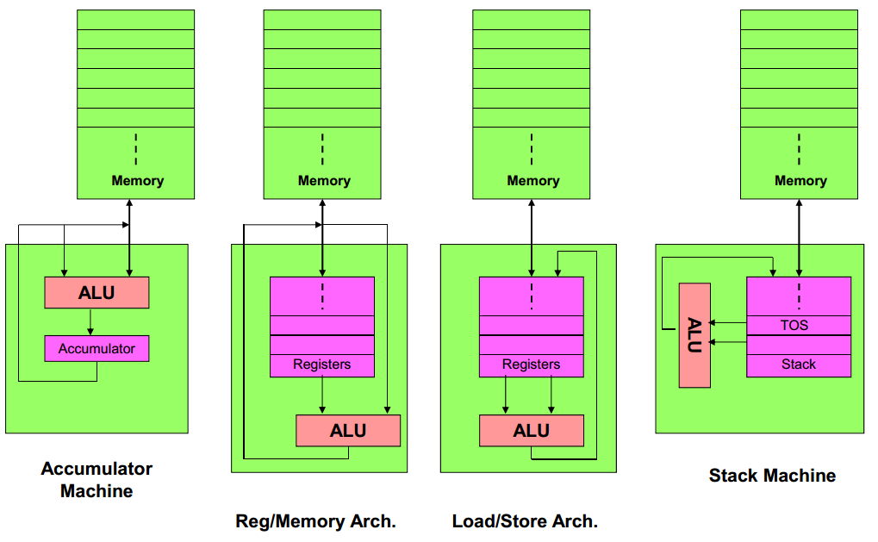
Basic ISA classes

Slide 5
Basic ISA classes
Code sequence for C = (A + B) / B
Stack | Accumulator | Register (register-memory) | Register (load-store)
Push A Push B Add Push B Div Pop C | Load A Add B Div B Store C | Load R1, A Add R1, B Div R1, B Store C, R1 | Load R1, A Load R2, B Add R3, R1, R2 Div R3, R3, R2 Store C, R3

Slide 6
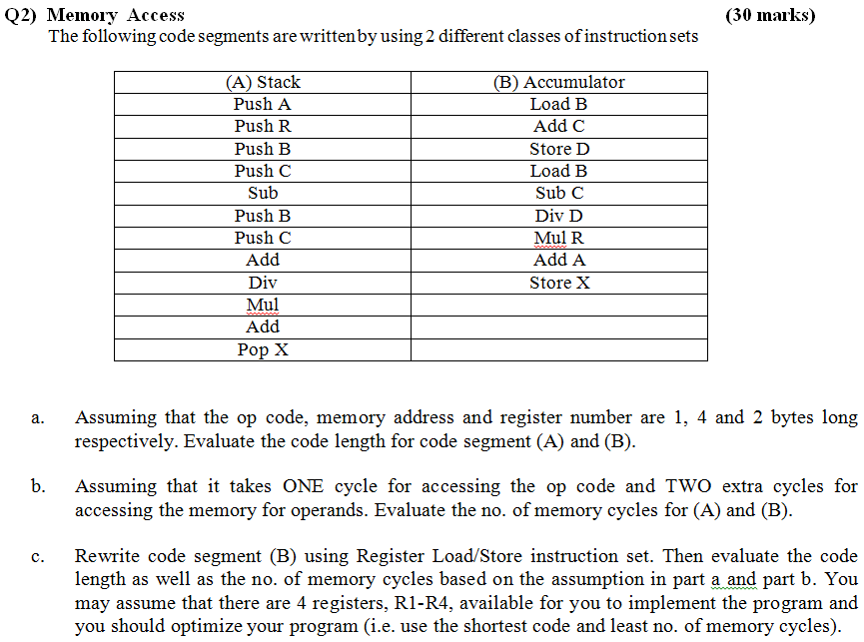

Slide 7
Address computation

Slide 8
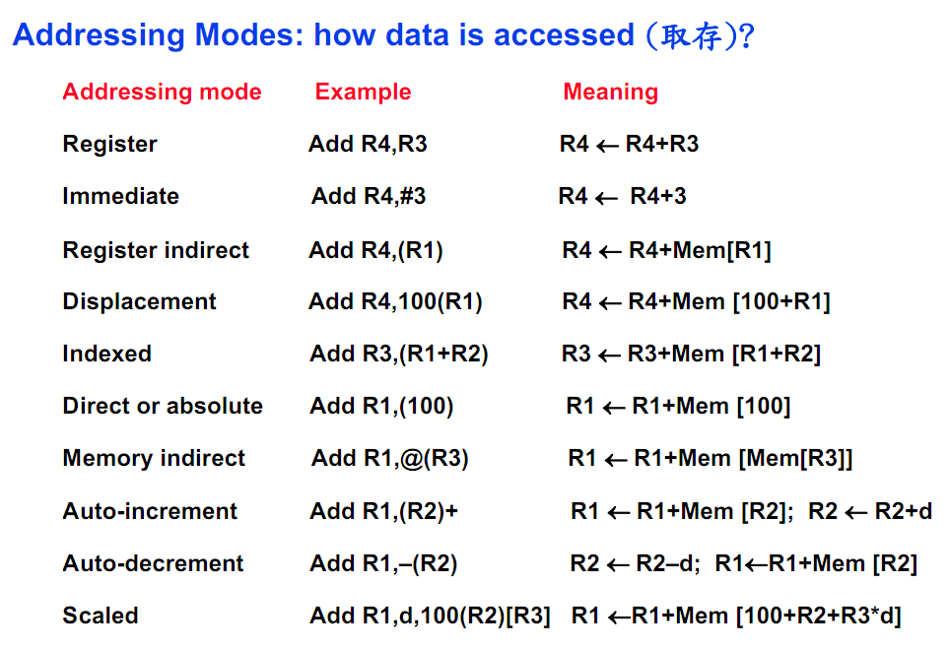
Address Computation

Slide 9
Address Computation - Register
Register
Memory
Register | Content
R1 | 0000 1000
R2 | 0000 2000
R3 | 0000 3000
R4 | 0000 4000
Address | Content
00002000 | 0000 2004
00002004 | 0000 2008
00002008 | 0000 200C
0000200C | 0000 4000
Add R1, R2 = R1 ← R1 + R2
Register | Content
R1 | 0000 3000
R2 | 0000 2000
R3 | 0000 3000
R4 | 0000 4000
1000 + 2000 = 3000

Slide 10
Address Computation - Immediate
Register
Memory
Register | Content
R1 | 0000 1000
R2 | 0000 2000
R3 | 0000 3000
R4 | 0000 4000
Address | Content
00002000 | 0000 2004
00002004 | 0000 2008
00002008 | 0000 200C
0000200C | 0000 4000
Add R3, #9000 = R3 ← R3 + 9000
Register | Content
R1 | 0000 1000
R2 | 0000 2000
R3 | 0000 C000
R4 | 0000 4000
3000 + 9000 = C000

Slide 11
Address Computation – Register Indirect
Register
Memory
Register | Content
R1 | 0000 2000
R2 | 0000 2008
R3 | 0000 AAAA
R4 | 0000 2004
Address | Content
00002000 | 0000 2004
00002004 | 0000 2008
00002008 | 0000 200C
0000200C | 0000 4000
Add R1, (R2) = R1 ← R1 + Mem[R2]
Register | Content
R1 | 0000 400C
R2 | 0000 2008
R3 | 0000 AAAA
R4 | 0000 2004
2000 + 200C = 400C

Slide 12
Address Computation - Displacement
Register
Memory
Register | Content
R1 | 0000 2000
R2 | 0000 2008
R3 | 0000 AAAA
R4 | 0000 2004
Address | Content
00002000 | 0000 2004
00002004 | 0000 2008
00002008 | 0000 200C
0000200C | 0000 4000
Add R1, 4(R2) = R1 ← R1 + Mem[R2+4]
Register | Content
R1 | 0000 6000
R2 | 0000 2008
R3 | 0000 AAAA
R4 | 0000 2004
2000 + 4000 = 6000

Slide 13
Address Computation - Indexed
Register
Memory
Register | Content
R1 | 0000 2000
R2 | 0000 2008
R3 | 0000 AAAA
R4 | 0000 0004
Address | Content
00002000 | 0000 2004
00002004 | 0000 BBBB
00002008 | 0000 200C
0000200C | 0000 4000
Add R2, (R1+R4) = R2 ← R2 + Mem[R1+R4]
Register | Content
R1 | 0000 2000
R2 | 0000 DBC3
R3 | 0000 AAAA
R4 | 0000 2004
2008 + Mem[2000 + 4]
= 2008 + BBBB
= DBC3

Slide 14
Address Computation – Direct/Absolute
Register
Memory
Register | Content
R1 | 0000 2000
R2 | 0000 2008
R3 | 0000 AAAA
R4 | 0000 0004
Address | Content
00002000 | 0000 2004
00002004 | 0000 BBBB
00002008 | 0000 200C
0000200C | 0000 4000
Add R1, (2000) = R1 ← R1 + Mem[2000]
Register | Content
R1 | 0000 4004
R2 | 0000 2008
R3 | 0000 AAAA
R4 | 0000 0004
2000 + 2004 = 4004

Slide 15
Address Computation – Memory Indirect
Register
Memory
Register | Content
R1 | 0000 2000
R2 | 0000 2008
R3 | 0000 AAAA
R4 | 0000 0004
Address | Content
00002000 | 0000 2004
00002004 | 0000 BBBB
00002008 | 0000 200C
0000200C | 0000 4000
Add R3, @(R1) = R3 ← R3 + Mem[Mem[R1]]
Register | Content
R1 | 0000 2000
R2 | 0000 2008
R3 | 0001 6665
R4 | 0000 0004
AAAA + Mem[Mem[2000]]
= AAAA + Mem[2004]
= AAAA + BBBB
= 16665

Slide 16
Address Computation – Auto-increment
Register
Memory
Register | Content
R1 | 0000 2000
R2 | 0000 2008
R3 | 0000 200C
R4 | 0000 BBBB
Address | Content
00002000 | 0000 AAAA
00002004 | 0000 CCCC
00002008 | 0000 2004
0000200C | 0000 3000
Add R1, (R2)+ = R1 ← R1 + Mem[R2]
R2 ← R2 + d
Usually, d = 1 word = 4 bytes
Register | Content
R1 | 0000 4004
R2 | 0000 200C
R3 | 0000 200C
R4 | 0000 BBBB
R1 = 2000 + 2004 = 4004
R2 = 2008 + 4 = 200C

Slide 17
Address Computation – Auto-decrement
Register
Memory
Register | Content
R1 | 0000 2000
R2 | 0000 2008
R3 | 0000 200C
R4 | 0000 BBBB
Address | Content
00002000 | 0000 AAAA
00002004 | 0000 CCCC
00002008 | 0000 2004
0000200C | 0000 3000
Add R1, -(R2) = R2 ← R2 - d
R1 ← R1 + Mem[R2]
Usually, d = 1 word = 4 bytes
Register | Content
R1 | 0000 ECCC
R2 | 0000 2004
R3 | 0000 200C
R4 | 0000 BBBB
R2 = 2008 - 4 = 2004
R1 = 2000 + CCCC = ECCC

Slide 18
Address Computation – Scaled
Register
Memory
Register | Content
R1 | 0000 1000
R2 | 0000 1764
R3 | 0000 00F4
R4 | 0000 AAAA
Address | Content
00002000 | 0000 AAAA
00002004 | 0000 CCCC
00002008 | 0000 2004
0000200C | 0000 3000
Add R1, 8, 100(R2)[R3] =
R1←R1+Mem[100+R2+R3*8]
Register | Content
R1 | 0000 DCCC
R2 | 0000 1764
R3 | 0000 00F4
R4 | 0000 AAAA
1000 + Mem[100 + 1764 + F4 * 8]
= 1000 + Mem[2004]
= 1000 + CCCC
= DCCC

Slide 19
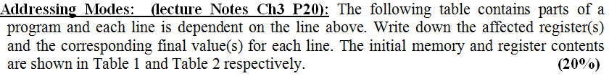
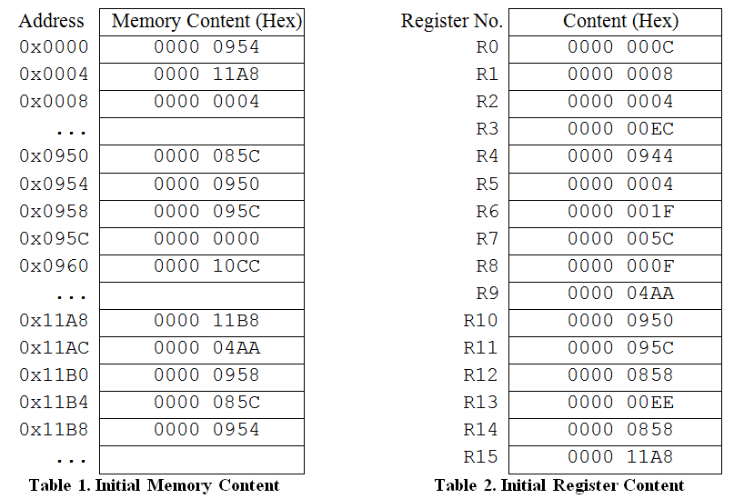
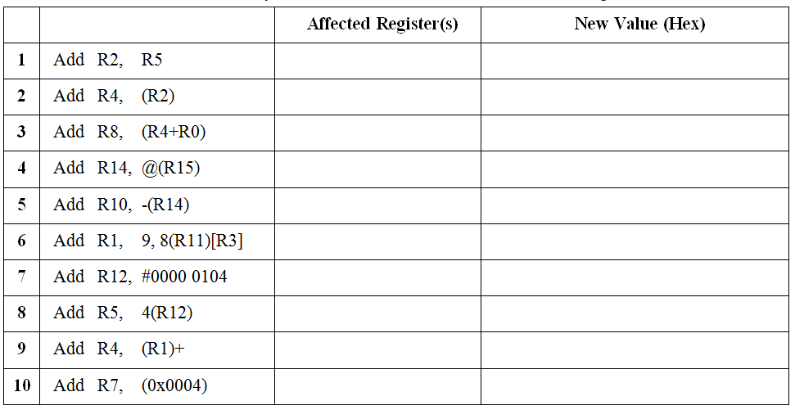
Examples

Slide 20
Project phase 1

Slide 21
Project Phase 1
Write 2 assembly programs according to the hash function
Hash Function=mod(last two digits of your student ID, 48)
Mod 48 | Problems | Mod 48 | Problems | Mod 48 | Problems | Mod 48 | Problems
0 | 1, 3 | 12 | 1, 4 | 24 | 1, 5 | 36 | 1,6
1 | 1, 7 | 13 | 1, 8 | 25 | 2, 3 | 37 | 2, 4
2 | 2, 5 | 14 | 2, 6 | 26 | 2, 7 | 38 | 2, 8
3 | 3, 1 | 15 | 3, 2 | 27 | 3, 5 | 39 | 3, 6
4 | 3, 7 | 16 | 3, 8 | 28 | 4, 1 | 40 | 4, 2
5 | 4, 5 | 17 | 4, 6 | 29 | 4, 7 | 41 | 4, 8
6 | 5, 1 | 18 | 5, 2 | 30 | 5, 3 | 42 | 5, 4
7 | 5, 7 | 19 | 5, 8 | 31 | 6, 1 | 43 | 6, 2
8 | 6, 3 | 20 | 6, 4 | 32 | 6, 7 | 44 | 6, 8
9 | 7, 1 | 21 | 7, 2 | 33 | 7, 3 | 45 | 7, 4
10 | 7, 5 | 22 | 7, 6 | 34 | 8, 1 | 46 | 8, 2
11 | 8, 3 | 23 | 8, 4 | 35 | 8, 5 | 47 | 8, 6

Slide 22
Project Phase 1 – Problem 1
Sort the number in ascending order

Slide 23
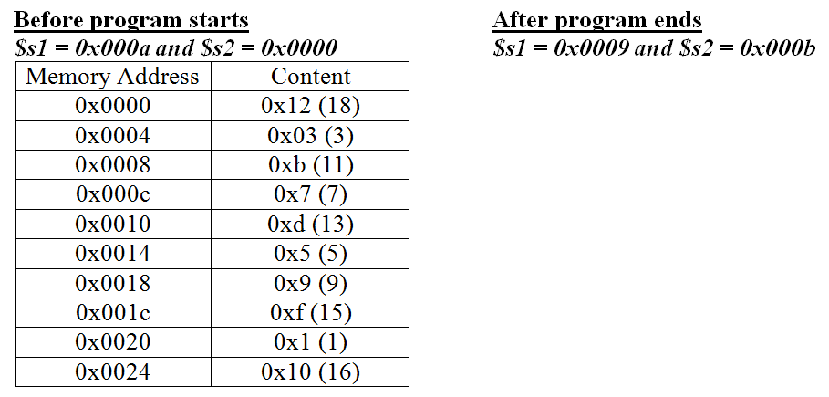
Project Phase 1 – Problem 2
Find the medium(s)

Slide 24
Project Phase 1 – Problem 3
Count the numbers that are even
The last number is always zero

Slide 25

Project Phase 1 – Problem 4
Sum the first n Fibonacci number
Example: n = 5, Sum = 0 + 1 + 1 + 2 + 3 = 7

Slide 26
Project Phase 1 – Problem 5
Sum all the digits of the number until a single digit is obtained
E.g. 256 = 2 + 5 + 6 = 13 = 1 + 3 = 4

Slide 27
Project Phase 1 – Problem 6
Find Greatest Common Factor and Least Common Multiple
E.g. x = 256 and y = 16, greatest common factor = 16 and least common multiple = 256

Slide 28
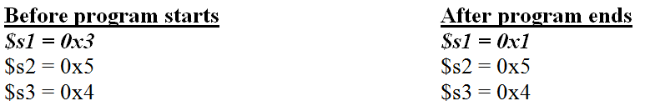
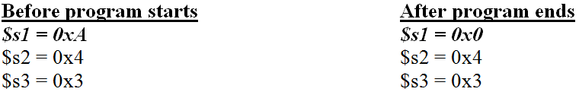
Project Phase 1 – Problem 7
Determine Pythagorean triple
Inputs are in random orders
Examples:
a = 3, b = 5 and c = 4
a = 10, b = 4 and c = 3

Slide 29
Project Phase 1 – Problem 8
Determine prime number
Example:
x = 7
x = 8

Slide 30
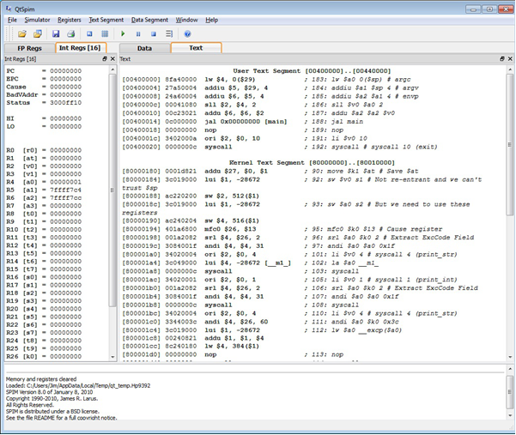
QtSpim – User Interface
Register content
Data Segment and Text Segment

Slide 31
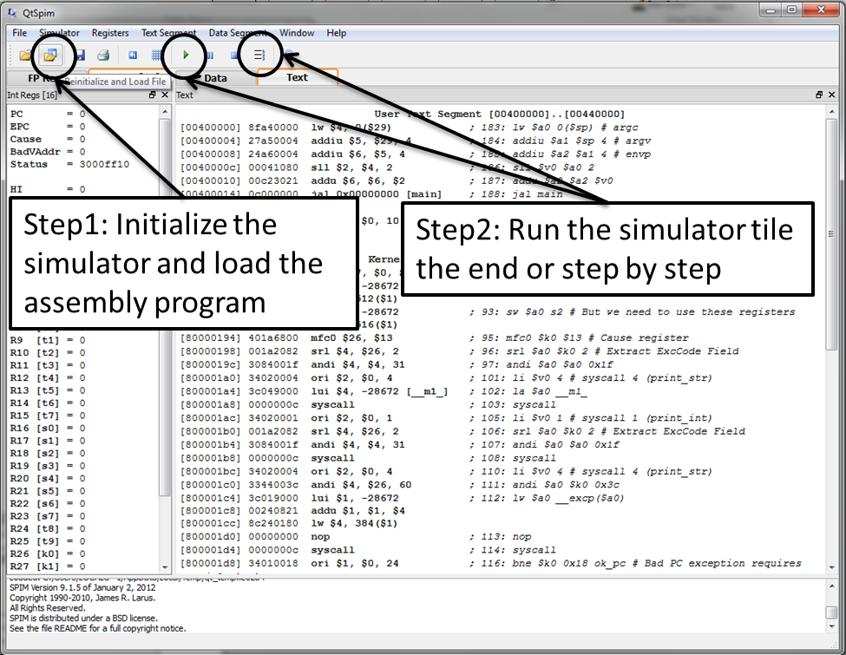
QtSpim – How to Run the Program

Slide 32
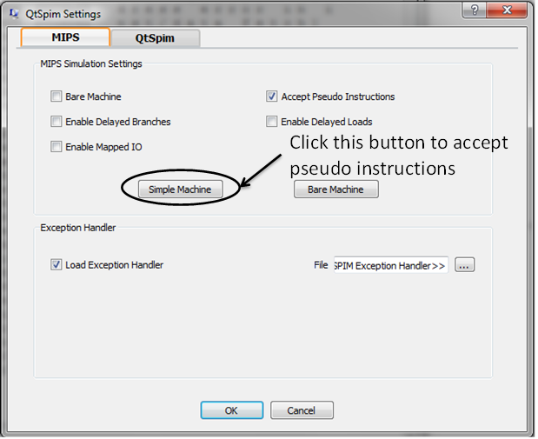
QtSpim – Setting

Slide 33
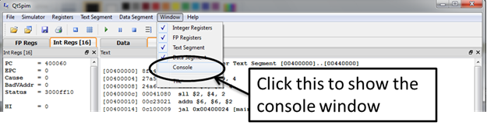
QtSpim – Console Output

Slide 34
Submission
Zip the assembly programs as sid.zip where sid = your student ID
You MUST submit the ZIP file to the submission system on our course homepage (within CUHK network), otherwise, we will NOT mark your assignment.
Late submission will NOT be entertained according to our submission system settings.
You can submit your project to our submission system infinite times, and only the most updated files will be marked.
Plagiarism will be seriously punished. We may randomly interview some students to check if they have done the problems themselves.

Slide 35
Questions?

